Slide 1
Dealing with Big Data
NIVT, Kolkata, 19th Sept. 2015

Slide 2
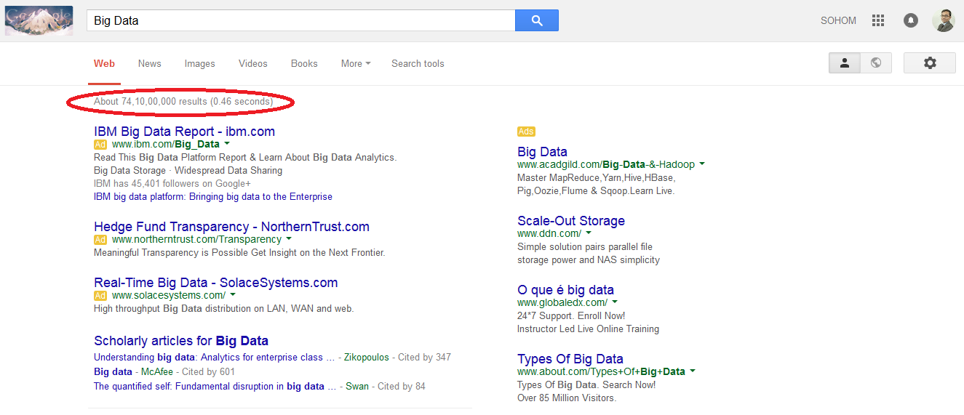
Google Big Data!!!

Slide 3
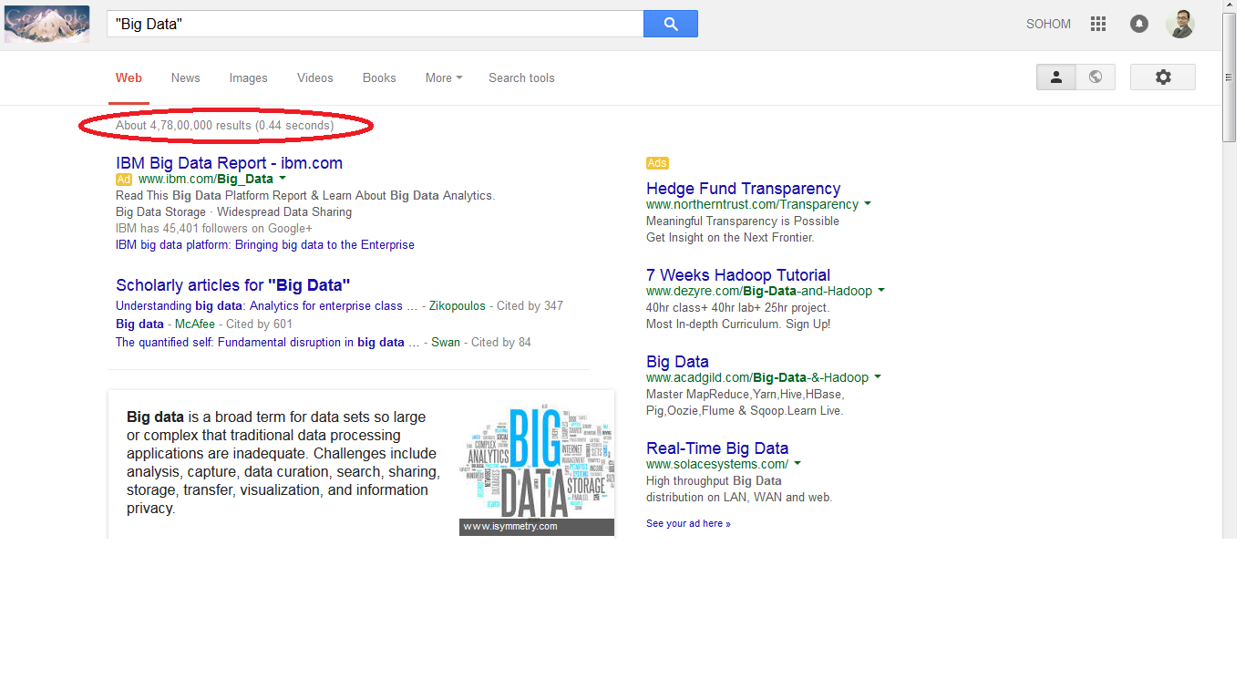
Google ”Big Data”!!!

Slide 4
Part-I
What is Big Data?
How is it generated?
Why should we study it?
Part-II
How to analyze it?
Some practical application

Slide 5
Part-I
What is Big Data?
How is it generated?
Why should we study it?

Slide 6
What is Data?
Facts and statistics collected together for reference or analysis
Data is raw, unorganized facts
Unprocessed form of information
Eg:- Text files, Image files, Video files and many others.

Slide 7
Types of Data
Unstructured Data
Semi-structured Data
Structured Data

Slide 8
Unstructured Data
The phrase "unstructured data" usually refers to information that doesn't reside in a traditional row-column database.
Unstructured data files often include text and multimedia content.
Examples include e-mail messages, word processing, documents, videos, photos, audio files, presentations, text corpus etc.

Slide 9
Semi-structured data
Semi-structured data is data that is neither raw data, nor typed data in a conventional database system.
Eg XML , JSON (JavaScript Object Notation)

Slide 10
Structured Data
Data that resides in fixed fields within a record or file. Relational databases and spreadsheets are examples of structured data.
Eg. Data stored in a database data type (numeric, currency, alphabetic, name, date, address).

Slide 11
Is it Big??!! How Big??!!

Slide 12
Is it Big??!! How Big??!!
Lets look at some StAtIsTiCs ☺

Slide 13
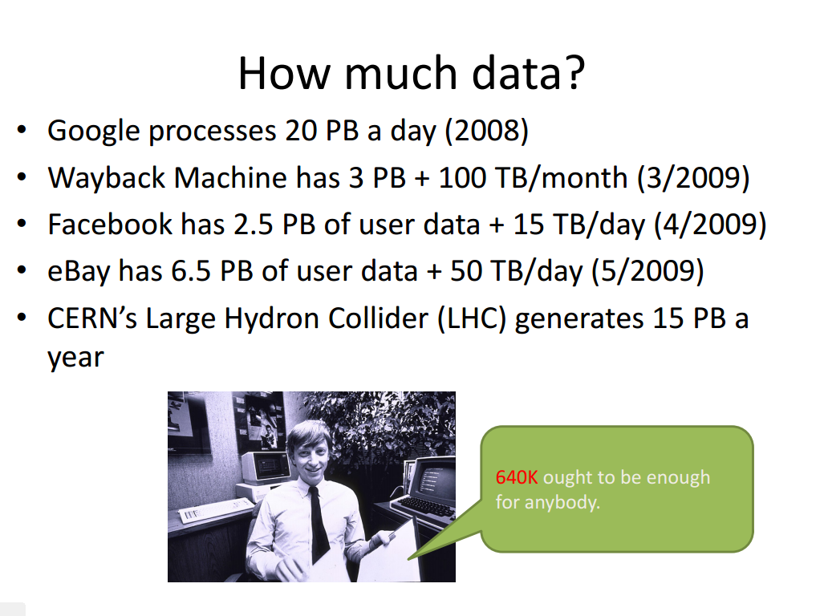

Slide 14
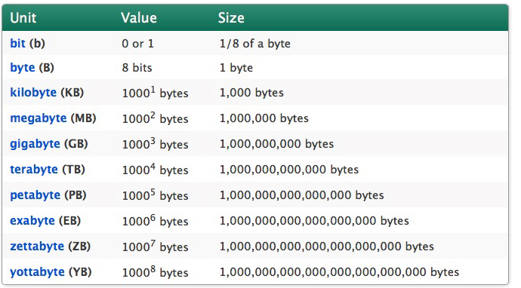
Units of Data

Slide 15
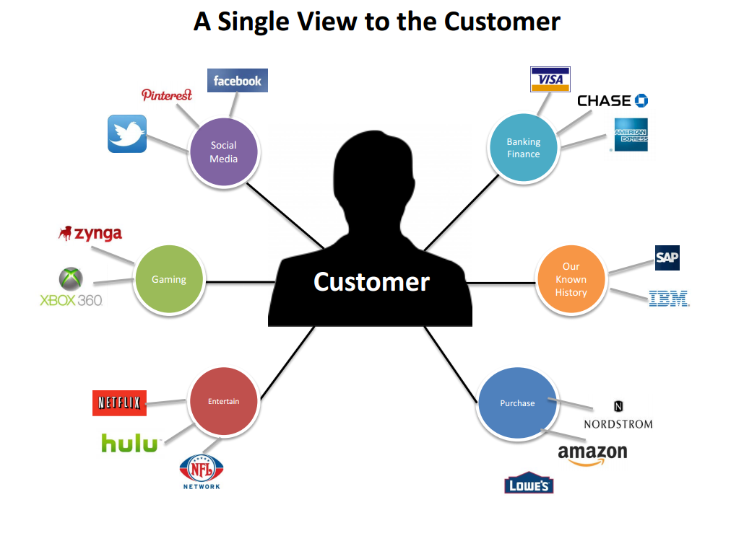
What is Big Data?
Lets look at an example:-

Slide 16
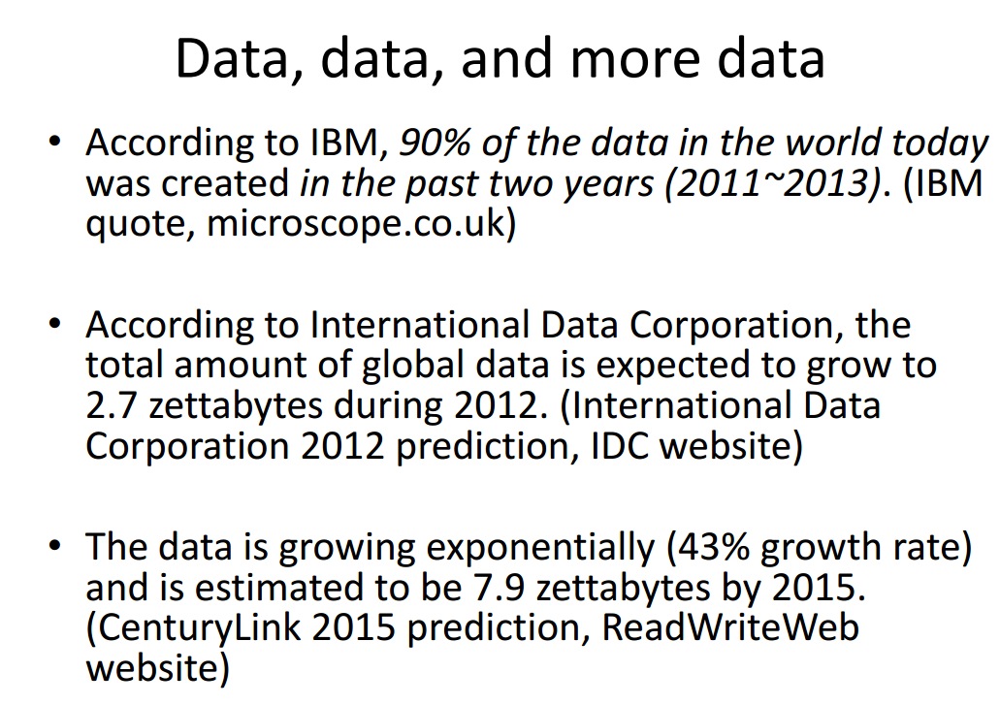

Slide 17
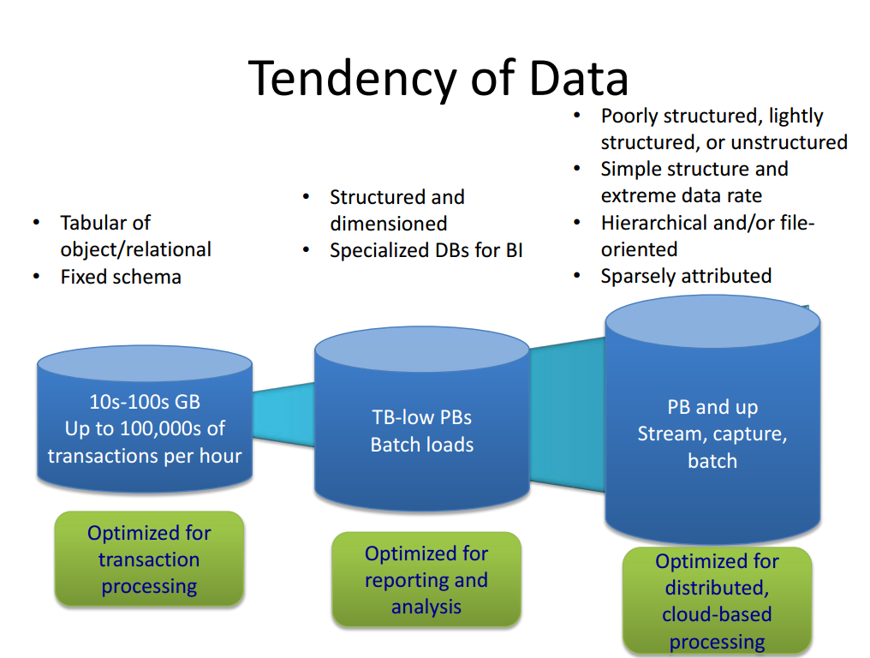

Slide 18
By Now!!! Have a Intuition about Big Data
What is it??

Slide 19
By Now!!! Have a Intuition about Big Data
What is it??
NO SINGLE DEFINITION

Slide 20
By Now!!! Have a Intuition about Big Data
What is it??
NO SINGLE DEFINITION
Generally we say: Big data is the term for a collection of datasets so large and complex that it becomes difficult to process using on-hand database management tools or traditional data processing applications.

Slide 21
Is it about the Big size of Data Sets?

Slide 22
Is it about the Big size of Data Sets?
Big Data is any data that is expensive to manage and hard to extract from.
-Michael Franklin
Thomas M. Siebel Professor of Computer Science,
Director of Algorithms, Machines and People Lab
University of Berkely

Slide 23
Characteristics of Big Data
3 V’s of Big Data: Volume, Variety, Velocity

Slide 24
Characteristics of Big Data
3 V’s of Big Data: Volume, Variety, Velocity
Add a new V make it four: V for Veracity

Slide 25
Characteristics of Big Data
3 V’s of Big Data: Volume, Variety, Velocity
Add a new V make it four: V for Veracity
Why add only one? Add 3 more… so its 7!!!

Slide 26
7 V’s of Big Data
Volume
Variety
Velocity
Veracity
Variability
Visualization
Value

Slide 27
Volume
100 terabytes of data are uploaded daily to Facebook; Akamai analyses 75 million events a day to target online ads; Walmart handles 1 million customer transactions every single hour. 90% of all data ever created was generated in the past 2 years. Scale is certainly a part of what makes Big Data big.

Slide 28
Velocity
Every minute of every day, we upload 100 hours of video on Youtube, send over 200 million emails and send 300,000 tweets. ‘Velocity’ refers to the increasing speed at which this data is created, and the increasing speed at which the data can be processed, stored and analysed by relational databases. The possibilities of processing data in real-time is an area of particular interest, which allows companies to do things like display personalised ads on the web pages you visit, based on your recent search, viewing and purchase history.

Slide 29
Variety
90% of data generated is ‘unstructured’, coming in all shapes and forms- from geo-spatial data, to tweets which can be analysed for content and sentiment, to visual data such as photos and videos.

Slide 30
Veracity
Veracity Ξ Truthfulness
Uncertainty of Big Data
1 in 3 Business Leaders does not trust the information they use to make decision
Poor data quality costs US Economy around $3.1 Trillion a year
What’s crucial to understanding Big Data is the messy, noisy nature of it, and the amount of work that goes in to producing an accurate dataset before analysis can even begin.

Slide 31
Variability
Variability refers to data whose meaning is constantly changing. This is particularly the case when gathering data relies on language processing.
Eg. Share market prices, Comments/Likes about a particular products

Slide 32
Visualization
Once it’s been processed, you need a way of presenting the data in a manner that’s readable and accessible- this is where visualisation comes in. Visualisations can contain dozens of variables and parameters- a far cry from the x and y variables of your standard bar chart- and finding a way to present this information that makes the findings clear is one of the challenges of Big Data.
Softwares used: Tableau, etc.

Slide 33
Value
The potential value of Big Data is huge. Speaking about new Big Data initiatives in the US healthcare system last year, McKinsey estimated if these initiatives were rolled out system-wide, they “could account for 300 billion to450 billion in reduced health-care spending, or 12 to 17 percent of the $2.6 trillion baseline in US health-care costs”.

Slide 34
Any other V to be added?

Slide 35
Any other V to be added?
Yes….some more…

Slide 36
Any other V to be added?
Yes….some more…
Validity:- Refers to whether the data is correct for the intended use or not. Data collection system should be able to cleanse/sanitise the data before it enters into your big data pipeline.
Volatility:- Refers to for how long the data is valid. For example, user tracking cookies have a validity of years whereas NAT IP allocations done by the ISPs have a validity of a few hours.
…….MORE MAY BE ADDED IN FUTURE!!!!.....

Slide 37
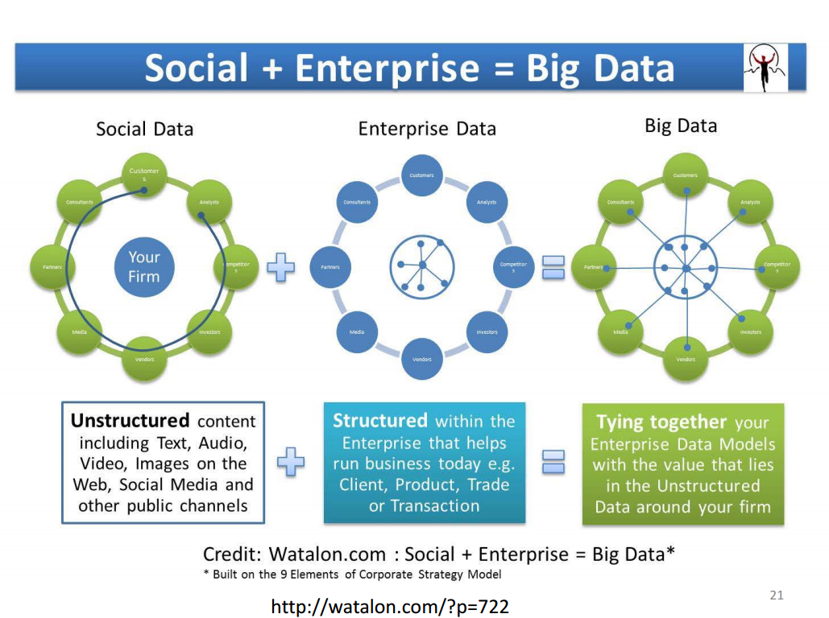

Slide 38
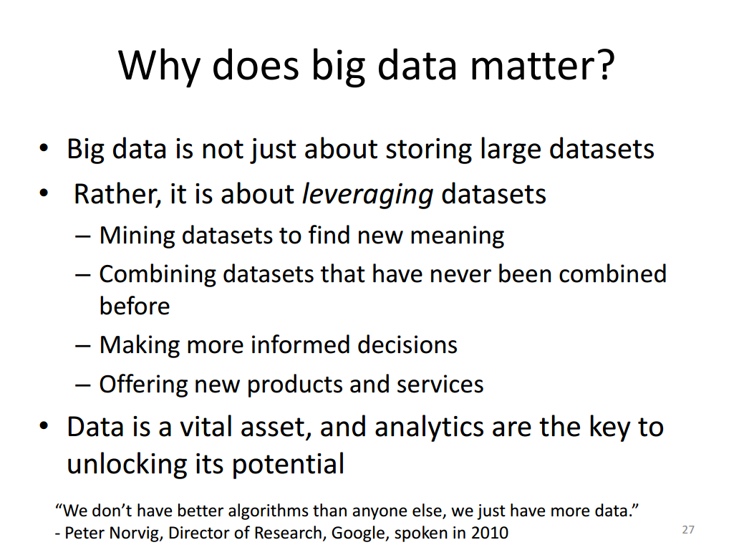

Slide 39
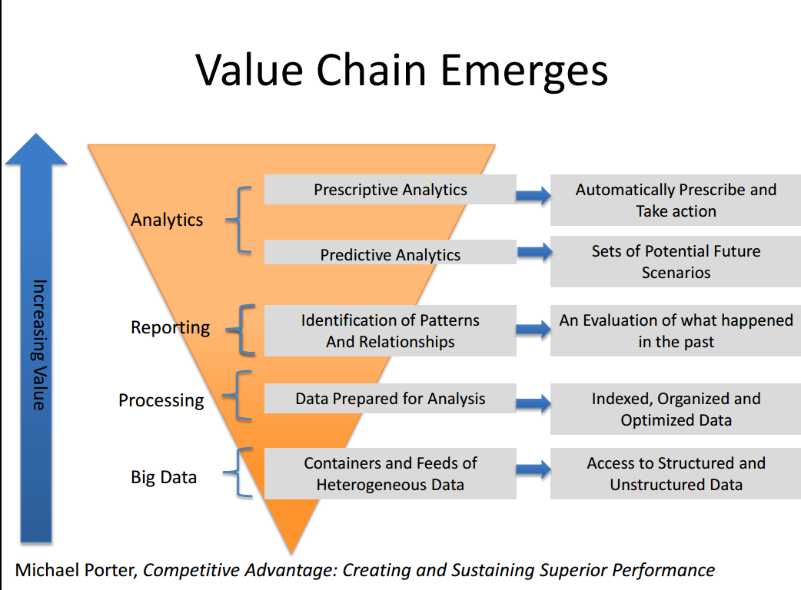

Slide 40
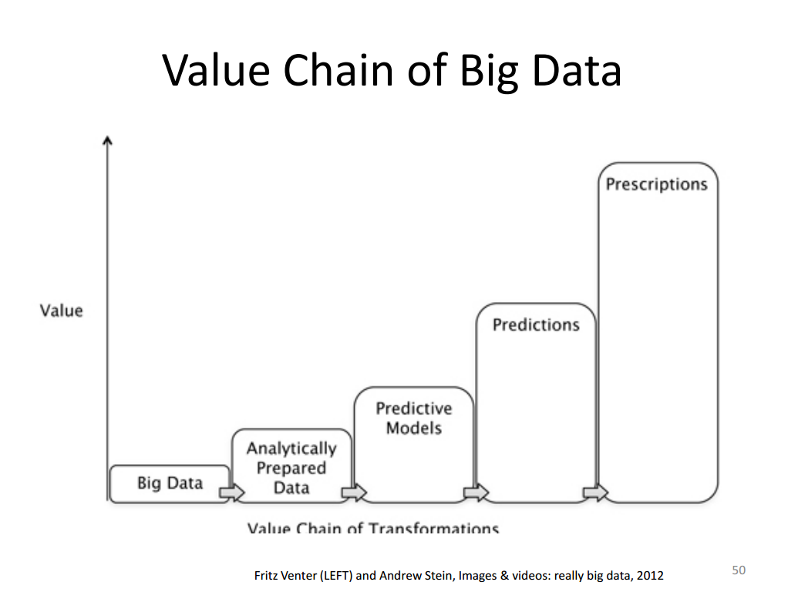

Slide 41
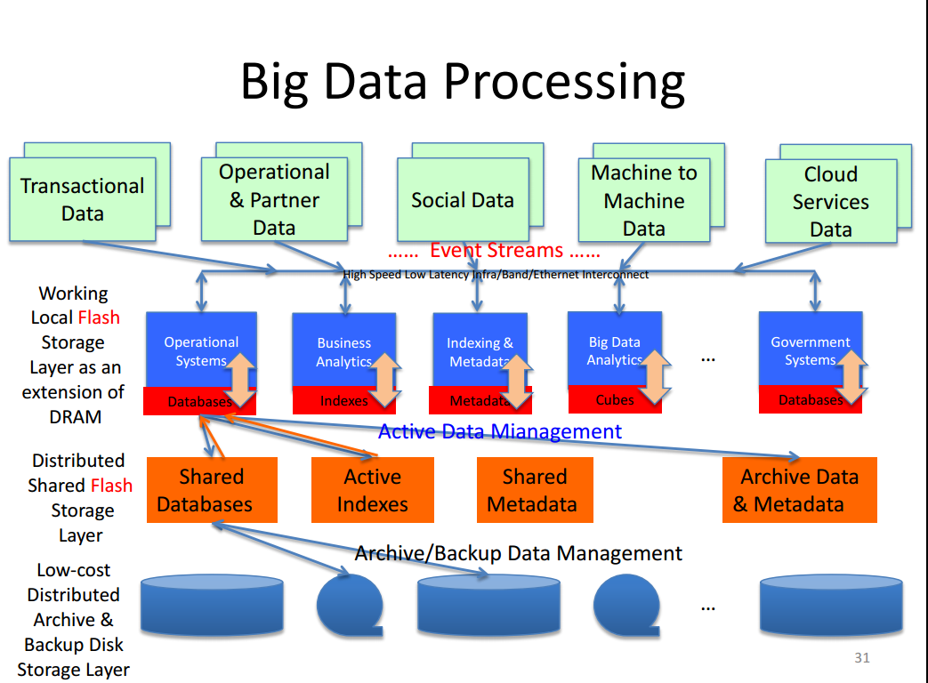

Slide 42
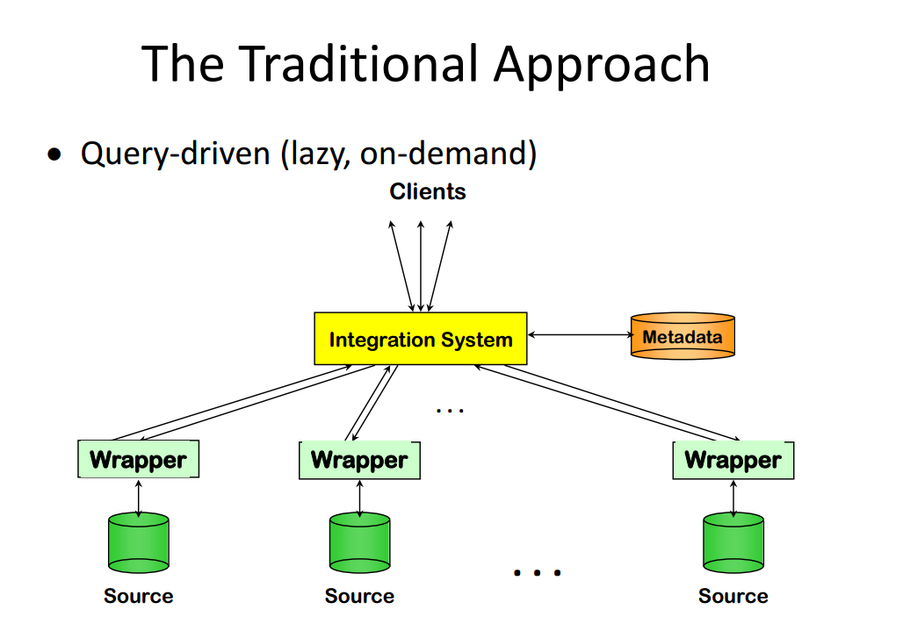

Slide 43
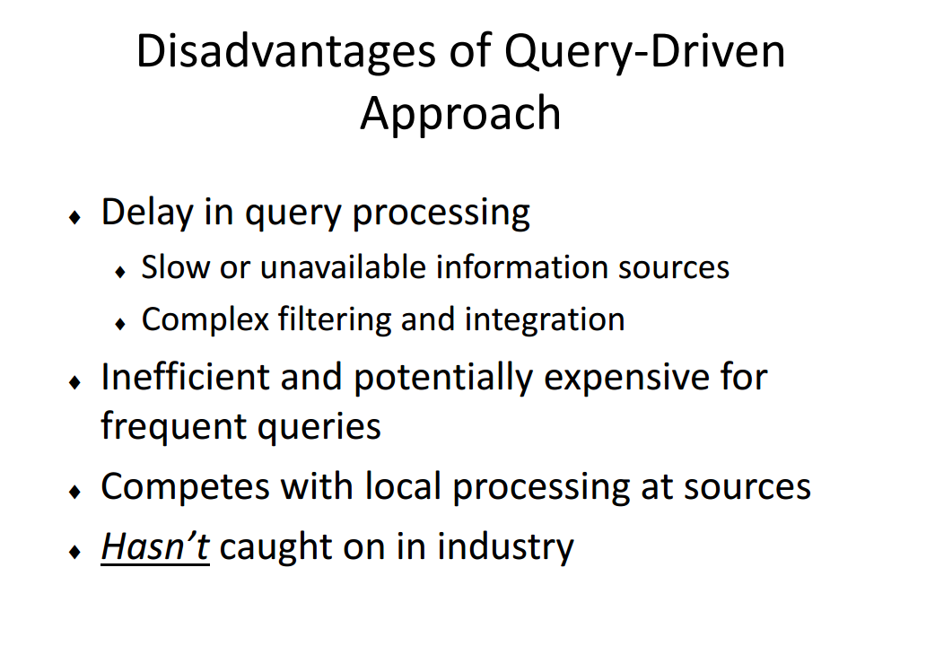

Slide 44
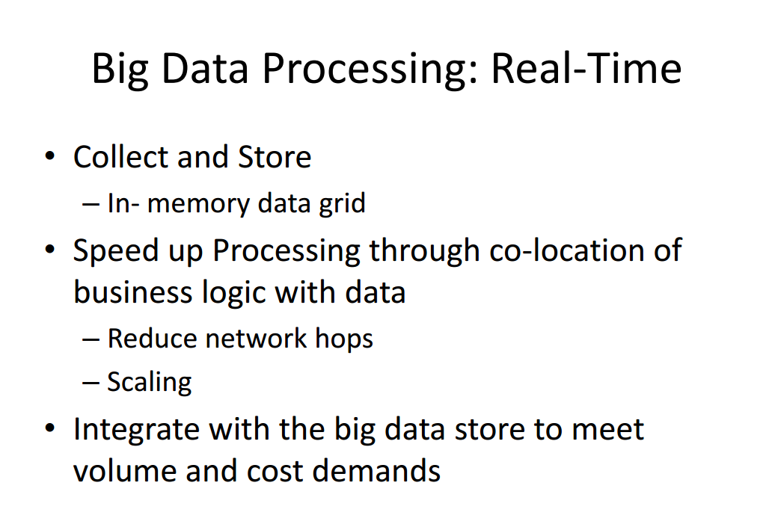

Slide 45
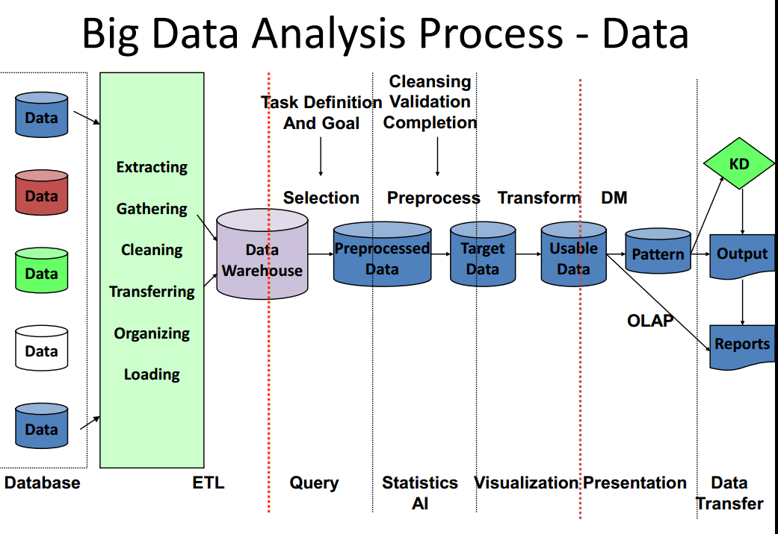

Slide 46
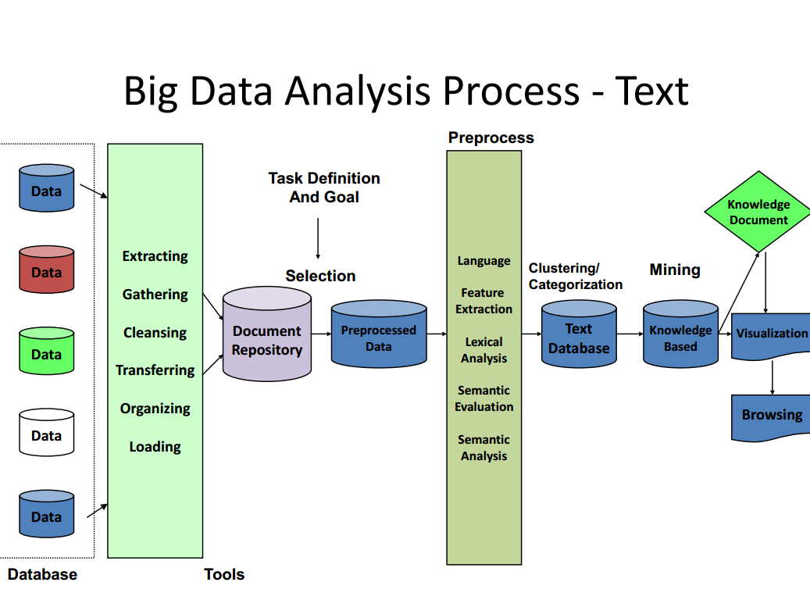

Slide 47
How to store Big Data?
Cloud
Database???!!!

Slide 48
Big Data in Cloud
AWS (Amazon Web Service):- Store, Process & Analyze Big Data
Scientists, developers, and many other technologists from many different industries are taking advantage of Amazon Web Services to perform big data analytics and meeting the challenges of the increasing volume, variety, and velocity of digital information. Amazon Web Services offers a comprehensive, end-to-end portfolio of cloud computing services to help you manage big data by reducing costs, scaling to meet demand, and increasing the speed of innovation.
Rackspace:- Big Data Platform provided by Rackspace

Slide 49
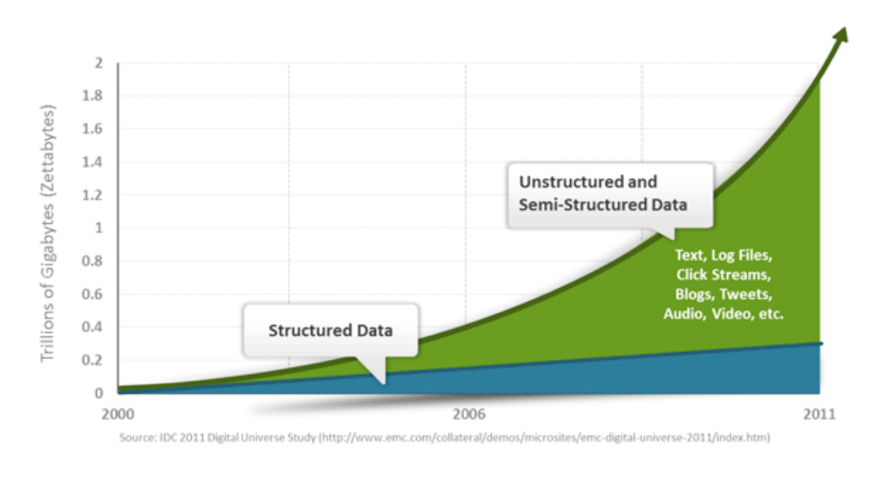
Big Data in Database!!!

Slide 50
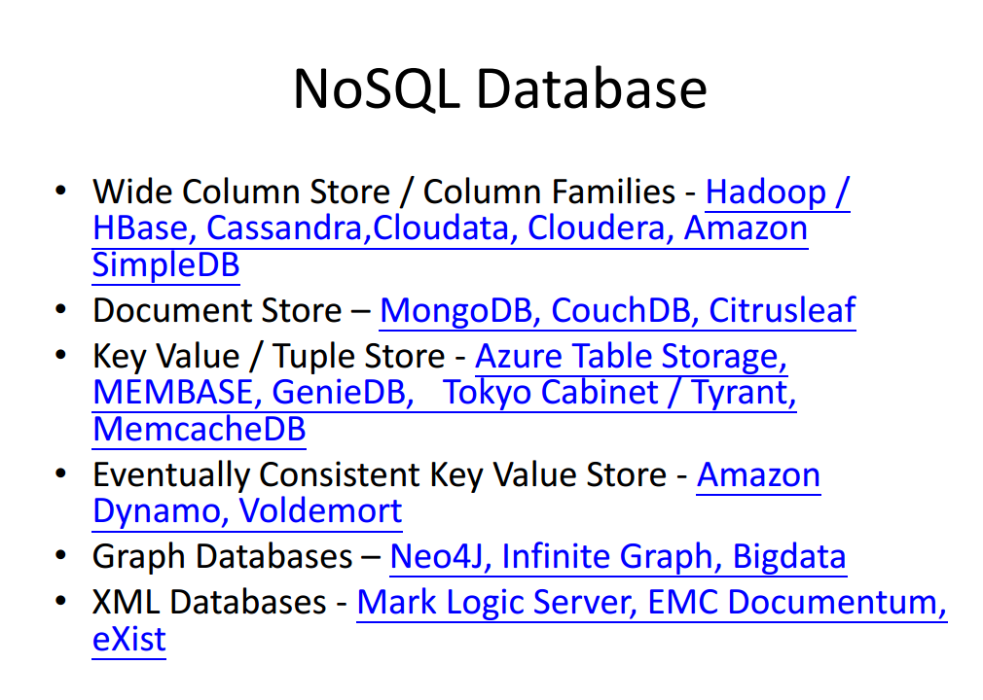

Slide 51
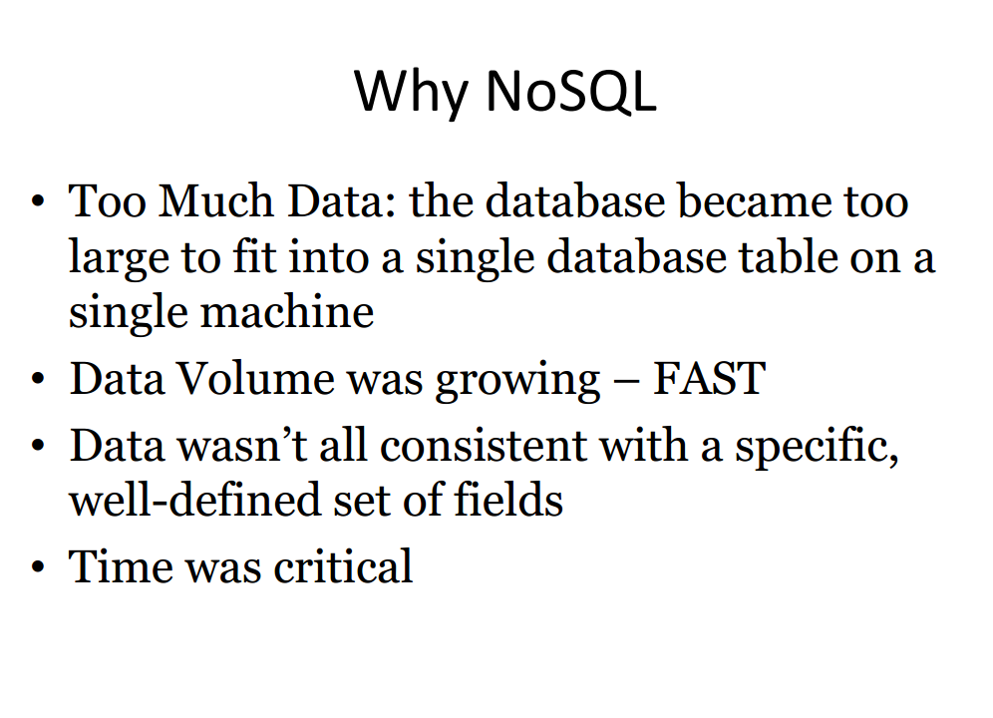

Slide 52
NOSQl example
Id | name | salary
101 | a | 100
102 | b | 200
IN NOSQL FORMAT:-
101 cloumn = cf:name ts value = ‘a’
101 cloumn = cf:salary ts value =100’
102 cloumn = cf:name ts value = ‘b’
102 cloumn = cf:salary ts value =200

Slide 53
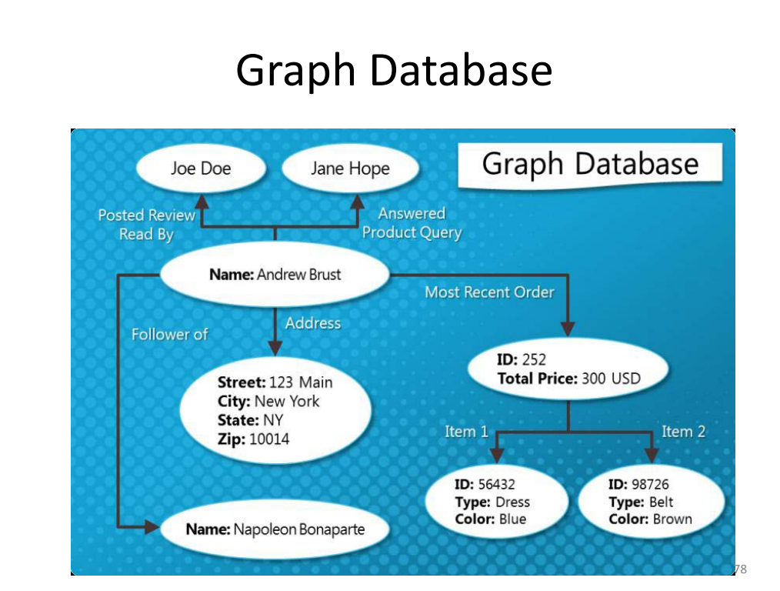

Slide 54
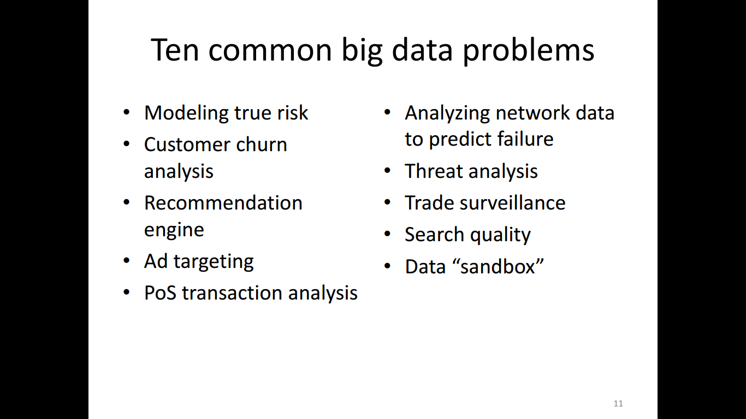
Notes:
A data sandbox, in the context of big data, is a scalable and developmental platform used to explore an organization's rich information sets through interaction and collaboration. It allows a company to realize its actual investment value in big data. A data sandbox includes massive parallel central processing units, high-end memory, high-capacity storage and I/O capacity and typically separates data experimentation and production database environments in data warehouses.
Point-of-sale (POS) is the place where a retail transaction is completed. It is the point at which a customer makes a payment to the merchant in exchange for goods or services

Slide 55
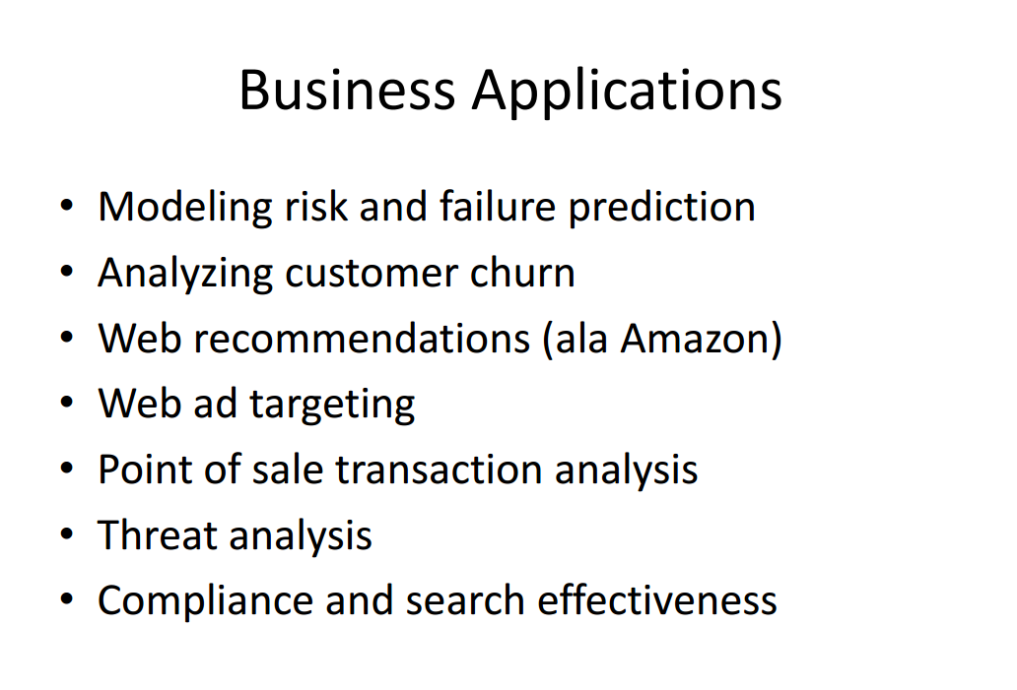

Slide 56
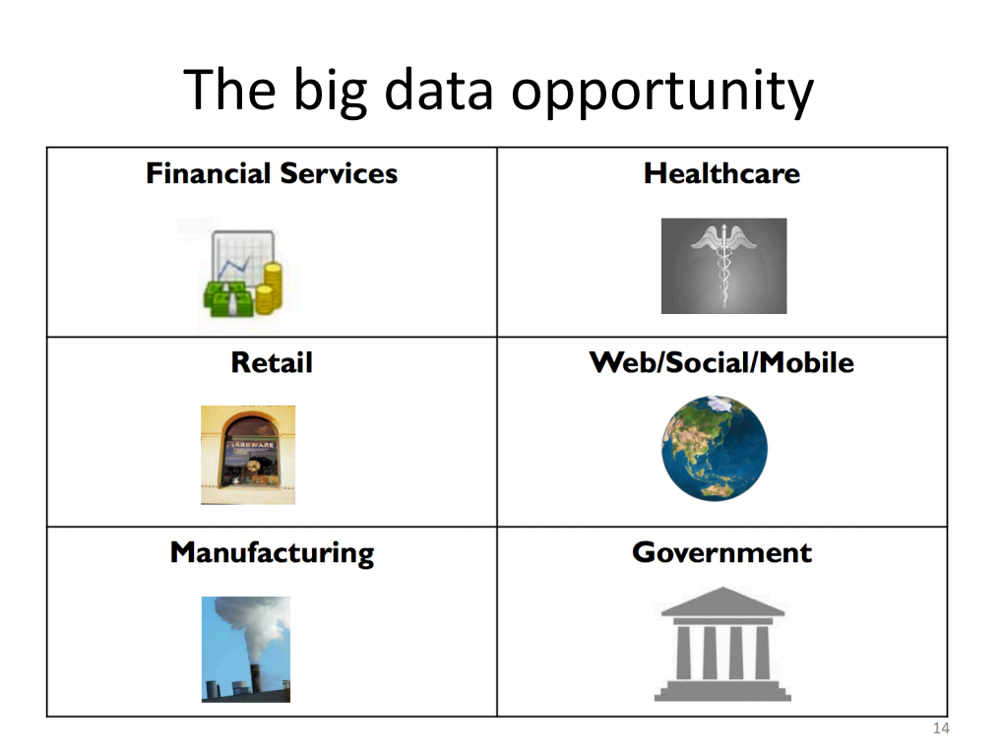

Slide 57
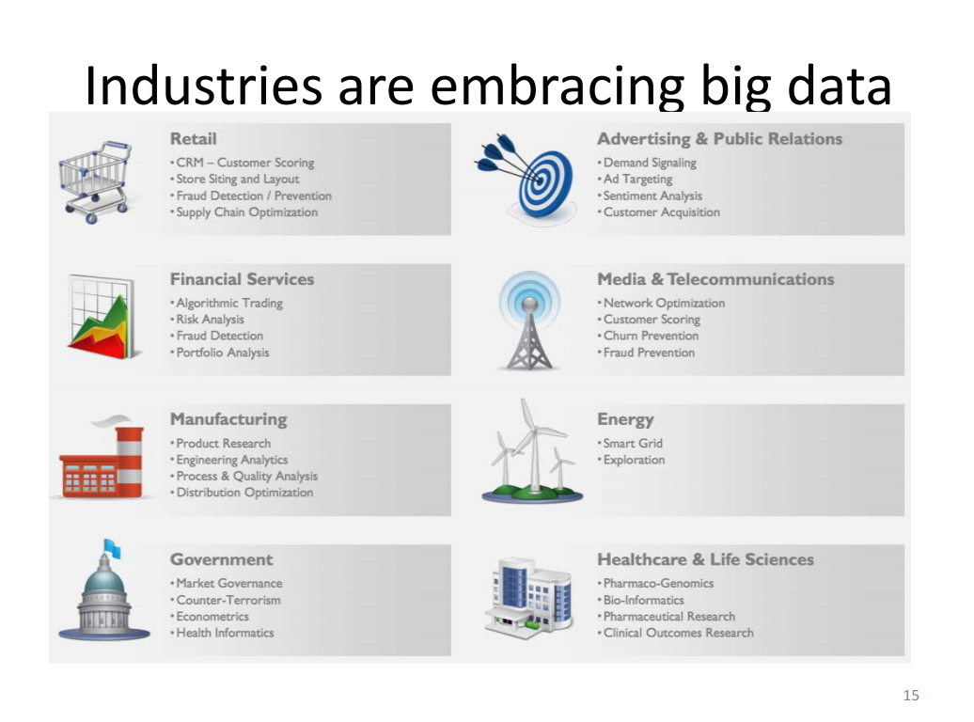

Slide 58
Big Data in Health Care

Slide 59
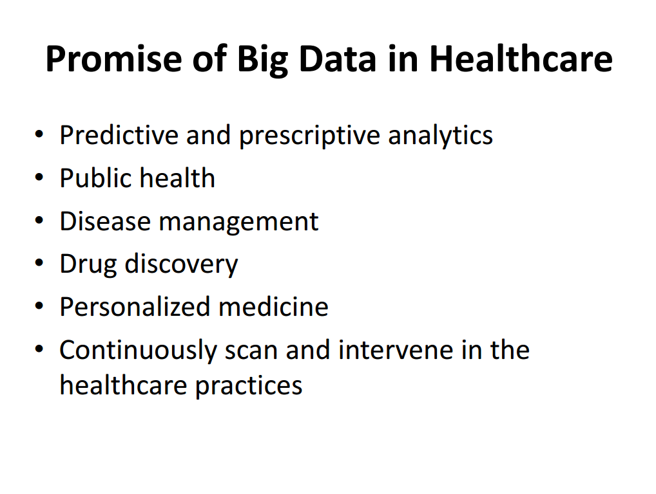

Slide 60
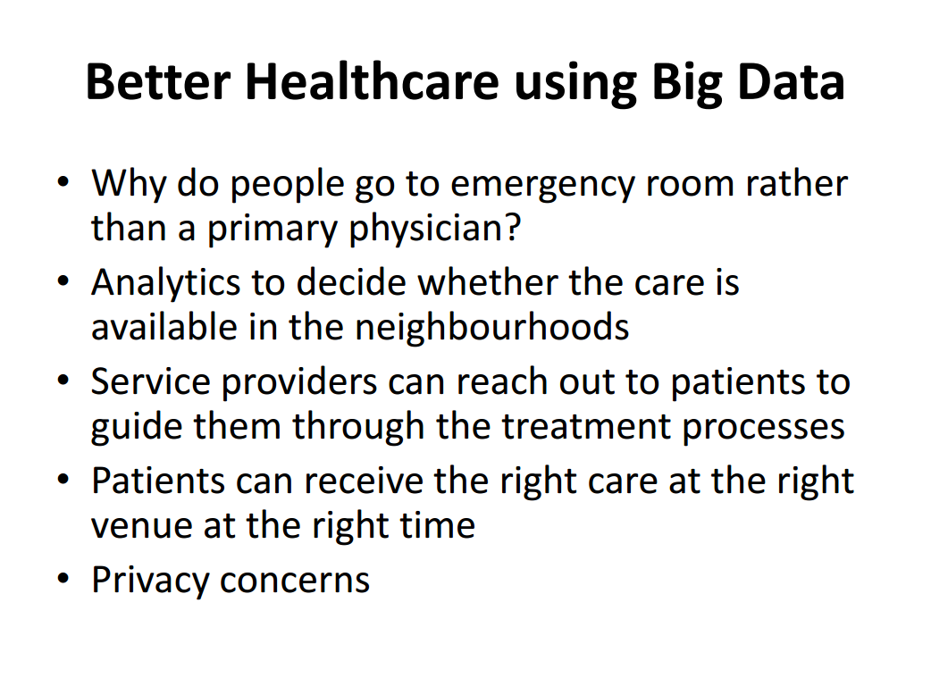

Slide 61
Big Data -> Research -> Deep Learning

Slide 62
Deep Learning
Deep -> More Layers -> More Training
Deep Learning = Machine Learning + Big Data
Deep Learning is about learning multiple levels of representation and abstraction that help to make sense of data.

Slide 63
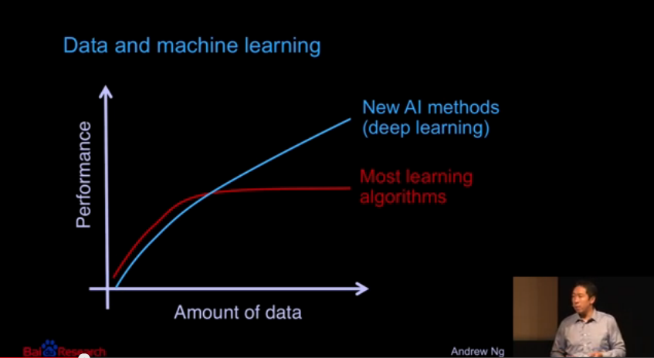
Deep Learning

Slide 64
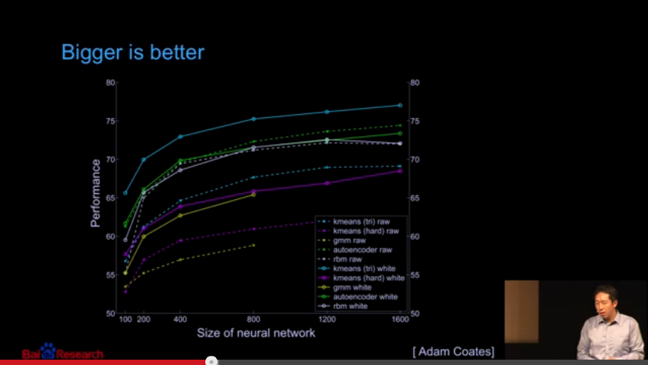
Bigger is Better!!!

Slide 65
Deep Learning Overview
Train the model with many layers
(vs shallow net with just a couple of layers)
Multiple layer to build an improved feature space
1st layer learns 1st order features (e.g. edges)
2nd layer learns higher order features (e.g. combination of 1st order features/edges)
Early layers usually learn in an unsupervised mode
Then the final layers are usually fed into supervised layer(s)
Source:- IIT-KGP MLCN workshop March 2015

Slide 66
Big Data Opportunities
Data Scientist: The Sexiest Job of 21st Century (Havard Business Review).
NASSCOM predicts that number of data analysts is going to increase to 2,50,000 from the current number of 50,000.
The Indian Big Data Industry is expected to grow from USD 200 million in 2012 to USD 1 billion in 2015 at a CAGR of 83%.

Slide 67
Part-II
How to analyze it?
Some practical application

Slide 68
Hadoop
Hadoop is an open source framework
HDFS
MapReduce

Slide 69
What is Hadoop?
An open source frame work used for storage and processing huge data sets in a cluster of commodity hardware.
Core Hadoop has two main components
Hadoop Distributed File System (HDFS): self-healing, high-bandwidth clustered storage
Reliable, redundant, distributed file system optimized for large files
MapReduce: fault-tolerant distributed processing
Programming model for processing sets of data
Mapping inputs to outputs and reducing the output of multiple Mappers to
Operates on unstructured and structured data
A large and active ecosystem
Open source under the friendly Apache License

Slide 70
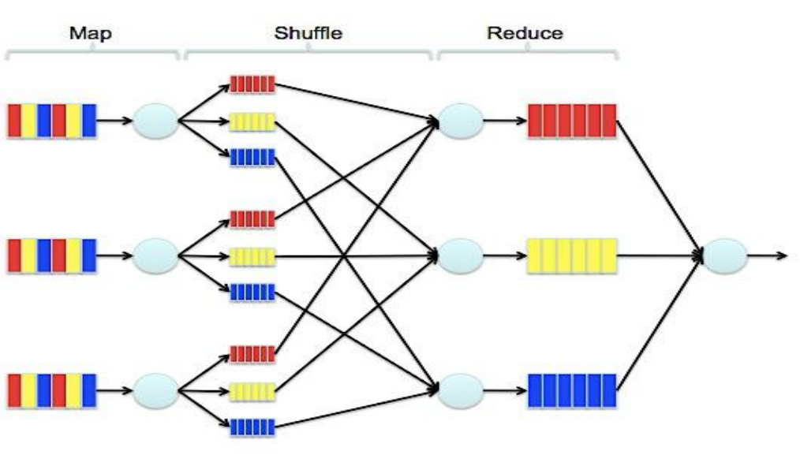
Map Reduce

Slide 71
What is Hive?
A data warehousing system to store structured data on Hadoop file
system
Provide an easy query these data by execution Hadoop MapReduce plans
Hive facilitates easy data summarization, ad-hoc queries, and the analysis of very large datasets that are stored in Hadoop .
Hive provides SQL interface, better known as HiveQL or HQL for short, which allows for easy querying for data in Hadoop .

Slide 72
What is PIG?
An alternative to Map Reduce
Built in Operations like join, group, sort etc.
Faster than Map Reduce
10 lines of Pig = 300 lines of Map Reduce code in Java (approx)

Slide 73
What is HBase?
Era of NoSQL (Not only SQL)
Built in NoSQL of Hadoop system is Hbase
Can handle structured as well as unstructured data.

Slide 74
What is Sqoop?
Sqoop is a connectivity tool for moving data from non-Hadoop data stores – such as relational databases and data warehouses – into Hadoop.

Slide 75
What is Mahout?
Mahout is a data mining library. It takes the most popular data mining algorithms for performing clustering, regression testing and statistical modeling and implements them using the Map Reduce model. Once big data is stored on the Hadoop Distributed File System (HDFS), Mahout provides the data science tools to automatically find meaningful patterns in those big data sets. The Apache Mahout project aims to make it faster and easier to turn big data into big information.
Source:- http://hortonworks.com/hadoop/mahout/

Slide 76
What Apache-Mahout does?
Mahout supports four main data science use cases:
Collaborative filtering – mines user behavior and makes product recommendations (e.g. Amazon recommendations)
Clustering – takes items in a particular class (such as web pages or newspaper articles) and organizes them into naturally occurring groups, such that items belonging to the same group are similar to each other
Classification – learns from existing categorizations and then assigns unclassified items to the best category
Frequent itemset mining – analyzes items in a group (e.g. items in a shopping cart or terms in a query session) and then identifies which items typically appear together
Source:- http://hortonworks.com/hadoop/mahout/

Slide 77
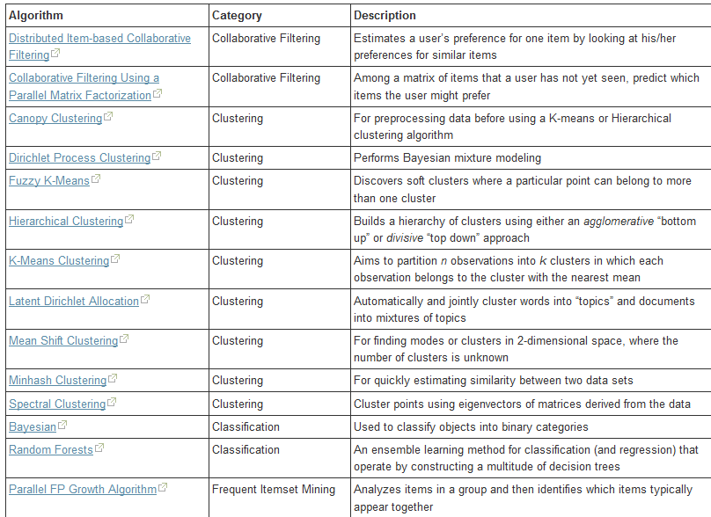
In Built Functions of Mahout
Source:- http://hortonworks.com/hadoop/mahout/
Notes:
FP-growth allows frequent itemset discovery. An efficient and scalable algorithm to complete set of frequent patterns. The rule {onion, potatoes}->burger found in the sales data of a supermarket would indicate that if a customer buys onions and potatoes together, they are likely to also buy hamburger meat.

Slide 78
Let me share my personal experience!!
OBJECTIVE: Building Recommendation System from Amazon co-purchase Network’s Topology
File sizes between 300 - 900 MB
Considering all time stamps the number of bi-directed edges are 5,853,404 while that of distinct edges are 10,847,450
Total number of reviews are 7,781,990
Tried to use fp-growth algorithm in laptop with 4GB RAM, Intel i3 processor
RESULT: 2 days 1 night the program executed with no output . (Finally Laptop got heated up and crashed!!!)
SOLUTION: Should have uploaded the file in HDFS and used Mahout

Slide 79
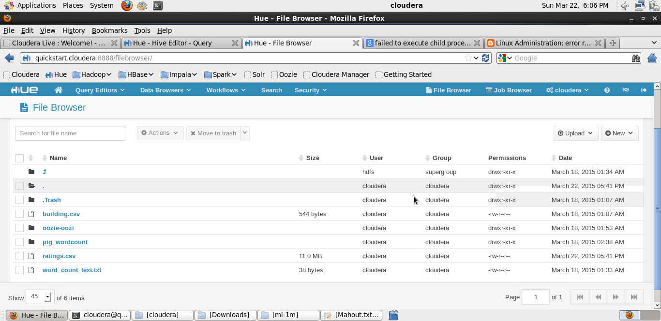
Lets look at some screenshots:-

Slide 80
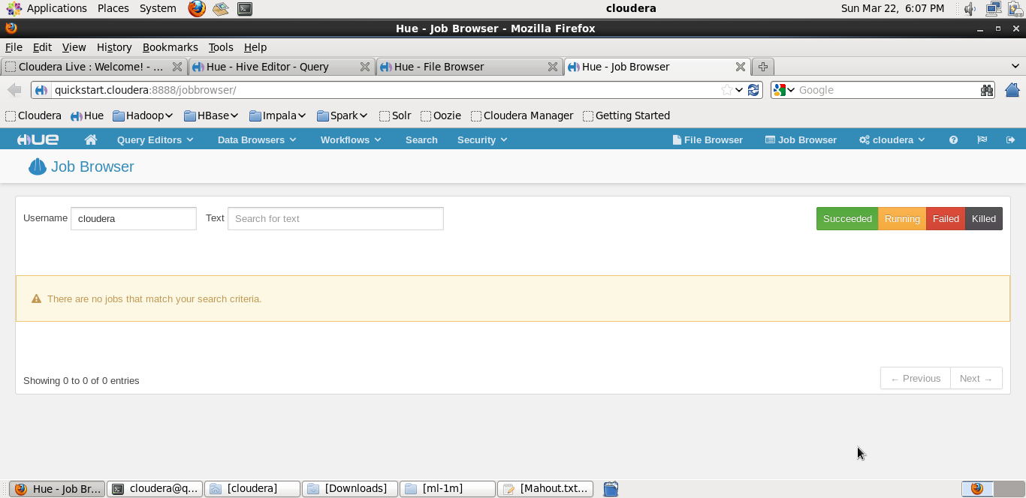
Job Browser

Slide 81
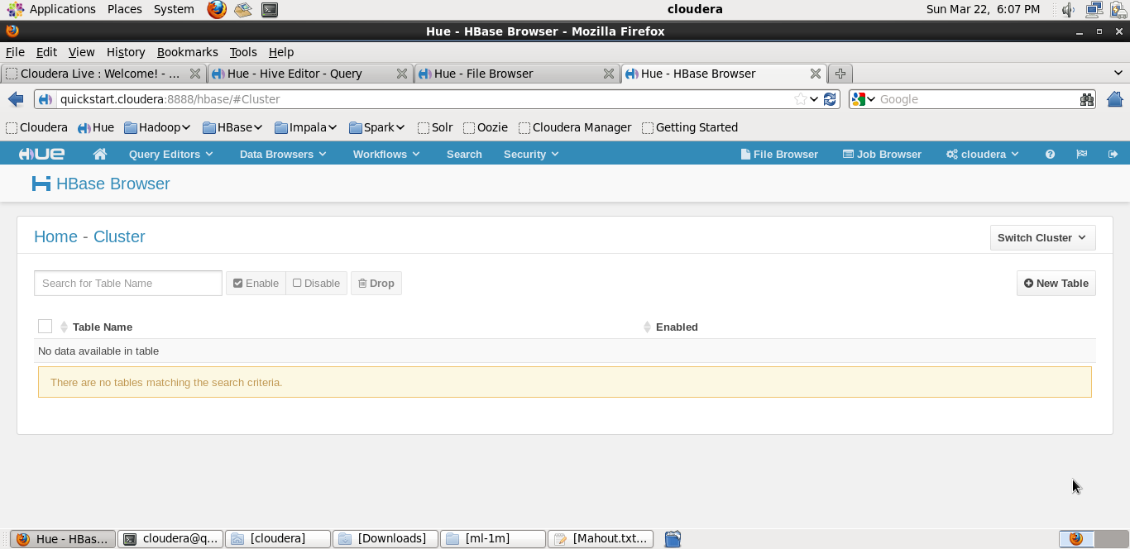
HBase

Slide 82
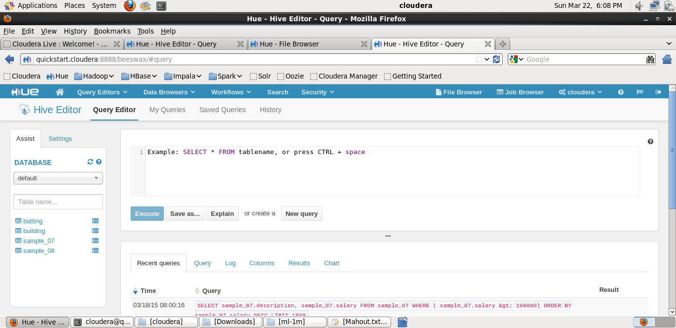
Hive Editor

Slide 83
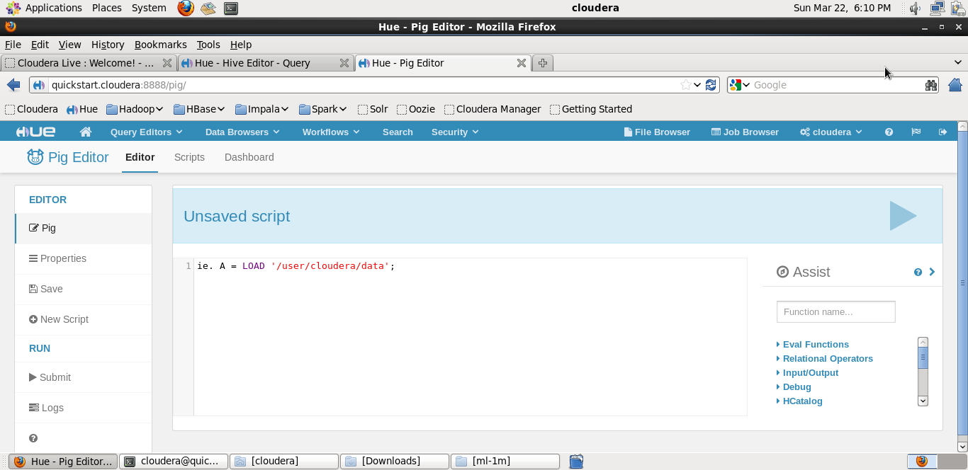
Pig Editor

Slide 84
Some Hadoop codes
hadoop fs –ls //gives a list of all files in the current hadoop cluster
hadoop fs –put prac.txt //puts the file named prac.txt in hdfs

Slide 85
Some PIG codes
A = LOAD ‘myfile.txt’ USING PigStorage(‘\t’) AS (f1,f2,f3);
Y= DISTINCT A //to get rid of the duplicates

Slide 86
Some Hive Codes
hive> show tables;
hive> create table SHAKESPEARE (freq INT,word STRING) row format delimited fields terminated by „\t‟ stored as textfile
hive> load data inpath “shakespeare_freq” into table shakespeare;
hive> load data inpath “shakespeare_freq” into table
shakespeare;
hive> select * from shakespeare where freq>100 sort by freq asc limit 10;

Slide 87
Recommended Readings
Big Data Now (O’REILLY publications)
Hadoop: The Definitive Guide (O’REILLY publications)
Kaggle
https://developer.yahoo.com/hadoop/tutorial
Kdnuggets
….may others.. Just Google….and Enjoy Learning!!!!

Slide 88
References
Big Data Analytics course as a part of ISWT at IIT-KGP
Big Data & Hadoop course at Kshare Academy
Intro to Hadoop & Map Reduce course Udacity
http://dataconomy.com/seven-vs-big-data/
Coursera.org
Machine Learning Lectures by Andrew Ng (Stanford University Open Courseware EdX)

Slide 89
References
Predictive Analytics –Eric Siegel, Wiley, 2013
Competing on Analytics –Davenport and Harris, Harvard School Press, 2007
Analytics at Work –Davenport, Harris, and Morrison, Harvard Business Press, 2010

Slide 90
References
• Bessler, D.A., Yang, J., The structure of interdependence in international stock markets. Journal of
International Money and Finance 22, 261-287, 2003.
• Eryiğit, M. and R. Eryiğit, Network structure of cross-correlations among the world market indices.
PhysicaA: Statistical Mechanics and its Applications 388(17): 3551-3562 , 2009.
• Adams, J., K. Faust, et al. , Capturing context: Integrating spatial and social network analyses. Social
Networks 34(1), 1-5, , 2012.
• Markose, Computability and evolutionary complexity: Markets as CAS, The economic journal, 115,
2005
• Tse, C.K., Liu, J., Lau, F.C.M., A network perspective of the stock market. Journal of Empirical Finance
doi:10.1016/j. jempfin.2010.04.008, 2010.
• Boginski, V., Butenko, S., Pardalos, P.M., Mining market data: A network approach. Computers &
Operations Research 33, 3171–3184, 2006.
• Wasserman, S. and K. Faust , Social Network Analysis: Methods and Applications."Cambridge
University Press: 461-502, 1994.

Slide 91
References
• Freeman, L.C., Centrality in social networks: Conceptual clarification. Social Networks 1, 215-239,
1979.
• Bonacich, P., Power and Centrality: A Family of Measures. The American Journal of Sociology 92,
1987.
• Roy, R. B. and U. K. Sarkar, A social network approach to examine the role of influential stocks in
shaping interdependence structure in global stock markets. International Conference on Advances
in Social Network Analysis and Mining (ASONAM), Kaohsiung, Taiwan, DOI:
10.1109/ASONAM.2011.87, 2011.
• Roy, R. B. and U. K. Sarkar, "A social network approach to change detection in the interdependence
structure of global stock markets." Social Network Analysis and Mining DOI 10.1007/s13278-012-0063-y, 2012.

Slide 92
References
• Freeman, L.C., Centrality in social networks: Conceptual clarification. Social Networks 1, 215-239,
1979.
• Bonacich, P., Power and Centrality: A Family of Measures. The American Journal of Sociology 92,
1987.
• Roy, R. B. and U. K. Sarkar, A social network approach to examine the role of influential stocks in
shaping interdependence structure in global stock markets. International Conference on Advances
in Social Network Analysis and Mining (ASONAM), Kaohsiung, Taiwan, DOI:
10.1109/ASONAM.2011.87, 2011.
• Roy, R. B. and U. K. Sarkar, "A social network approach to change detection in the interdependence
structure of global stock markets." Social Network Analysis and Mining DOI 10.1007/s13278-012-0063-y, 2012.

Slide 93
Thank You ☺

Slide 94
Questions & Answers
?

